Slide 1



Information Security Project
Second Deliverable
FileGuardian App: Encryption, Decryption, and Hashing
made by: Souha Dhafleoui and Mariem Ben Slama
Github link: https://github.com/mariem-ben-slama/security-project.git
Date: 04/05/2025

Slide 2

Design of the Application
The application will be a simple desktop tool for users to encrypt, decrypt, and hash files securely.
It will provide:
Easy file selection
Action choice (encrypt, decrypt, hash)
Password entry when needed
Success/error notifications
Automatic storage of processed files in organized folders
User Authentication(sign up & log in)

Slide 3




The Components
User Interface (UI): Displays buttons and fields for user interactions. Built with Tkinter.
File Handler: Loads and saves files selected by the user.
Authentication Module: Manages user registration and login. It securely saves credentials in a users.json file, using password hashing.
Encryption Module: Encrypts and decrypts files using the Cryptography library.
Hashing Module: Computes SHA-256 hashes of files.
Storage Manager: Saves processed files into proper folders (encrypted, decrypted, hashes)..

Slide 4

Roles
Unauthenticated User
Can only sign up or log in
Authenticated User
Can encrypt, decrypt, hash files, and view the output folders.
System (Application)
Grant or deny access based on authentication.
Executes the selected action and saves results securely.

Slide 5


Working Flows
Encryption Workflow
User logs in
Clicks "Encrypt File"
Chooses a file
Enters a password(used to derive encryption key)
File is encrypted and saved in encrypted_files/
Decryption Workflow
User logs in
Clicks "Decrypt File"
Selects encrypted file
Enters the same password that was used for encryption
File is decrypted and saved in decrypted_files/

Slide 6
Working Flows
Hashing Workflow
User logs in
Clicks "Hash File"
Selects file
SHA-256 hash is calculated and saved in hashes/
User Management Workflow
Sign up:
New username and password that’s turned into a hash.
Login:
Input checked against stored hash.

Slide 7
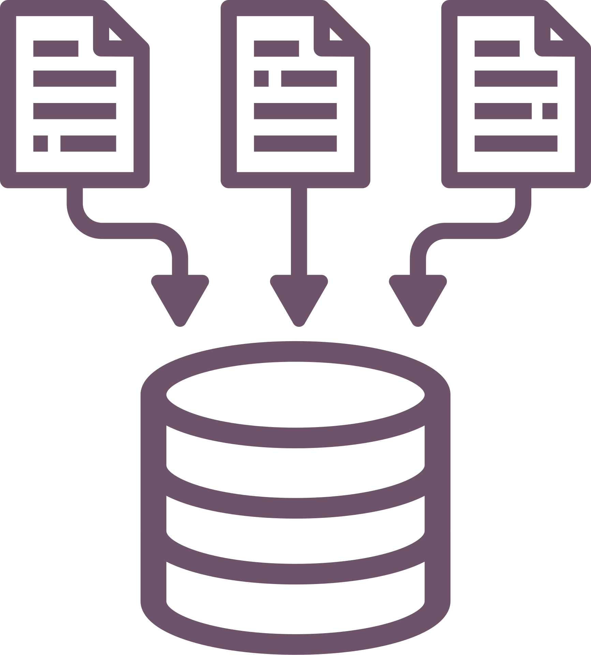
Exchanged Messages/Data
1.User Credentials:
Input: Username and password.
Stored as: Hashed password in users.json.
2.Encryption Key:
derived from password.
Saved as:
.key file.
Location: C:\file security
3.Encrypted Data:
Input: Original file selected by user.
Output: Encrypted file with .enc extension.
Location: C:\file security\encrypted_files
4.Decrypted Data:
Input: Encrypted file + password.
Output: Decrypted file with .dec extension.
Location: C:\file security\decrypted_files
5.Hashed Data:
Input: File selected by user for hashing.
Output: .hash file containing the SHA-256 digest.
Location: C:\file security\hashes

Slide 8

Tools Used
tkinter: For building the user interface GUI (login screen, buttons, file dialogs).
cryptography.Fernet: For symmetric encryption and decryption using a secure key
hashlib: To hash passwords and files using SHA-256.
json: To read/write the user database file (users.json).
os / pathlib: For path building, creating directories, and file access.
base64: To encode the derived key so it's Fernet-compatible.
filedialog: To let users choose files for encryption, decryption, and hashing.
messagebox: To show success or error messages.
simpledialog: To prompt users for password input.

Slide 9







Development Phases
1
Design login/signup system using JSON and SHA-256.
2
Implement file encryption with key derived from password.
3
Implement decryption with the same password-derived key.
4
Add hashing functionality (SHA-256).
5
Set up folder structure for storing all file outputs.
6
Build and style GUI with Tkinter.

Slide 10


Thank you for your attention

